Slide 1

LO3-Week 8-slide 2
Basic structure of An organization & an organigram design for a learning plan

Slide 2

Create an organization chart
https://support.microsoft.com/en-us/topic/create-an-organization-chart-9b51f667-11b7-4971-a757-a08a36684ee6

Slide 3
Hierarchical org structure
Picture organisational chart
Use to show hierarchical information or reporting relationships in an organization, with corresponding pictures. The assistant shape and the Org Chart hanging layouts are available with this layout.
T.A
Manager ABC Care Home
V.O
Supervisor
J.T
Care co-ordinator
M.W
Care Assistant
Y.K
Care Assistant

Slide 4
Organigram template example
Use to show hierarchical information or reporting relationships in an organization. Pictures appear in circles and corresponding text appears next to the pictures.
Tayo
Care Manager

Slide 5
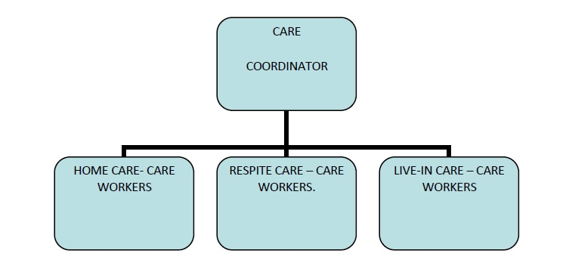
Care Team
Our care teams comprise of a Care Cordinator and a small team of carers split across the three service areas.
This flat delivery structure means we can react to increases in workload either within a team or across teams.
Care Coordinator
Home Care Carer
Respite Carer
Live-In Carer
https://www.icrithealthcare.co.uk/our-staff/organisational-structure?jjj=1621891915872

Slide 6

Hierarchical org structure

Slide 7
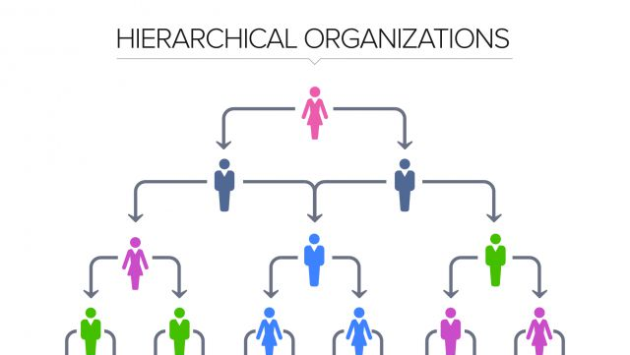
Hierarchical org structure.

Slide 8
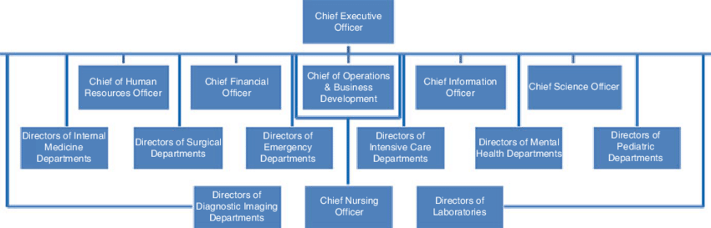
Typical organizational chart for a hospital

Slide 9
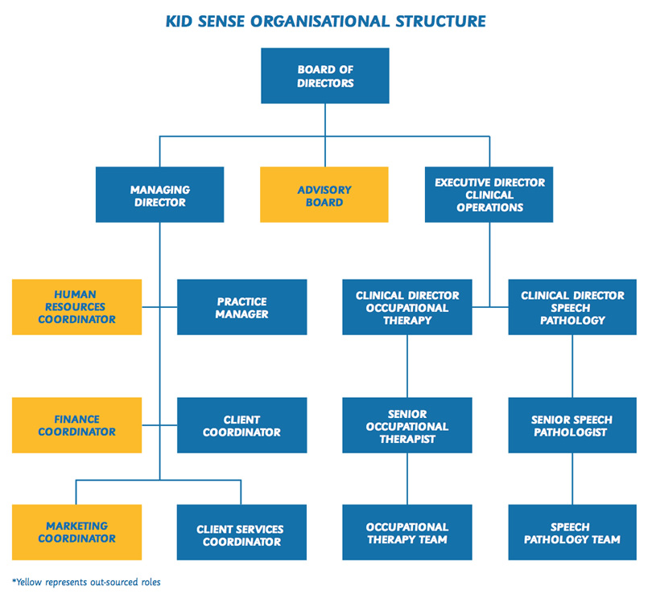

Slide 10
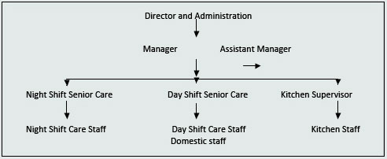

Slide 12
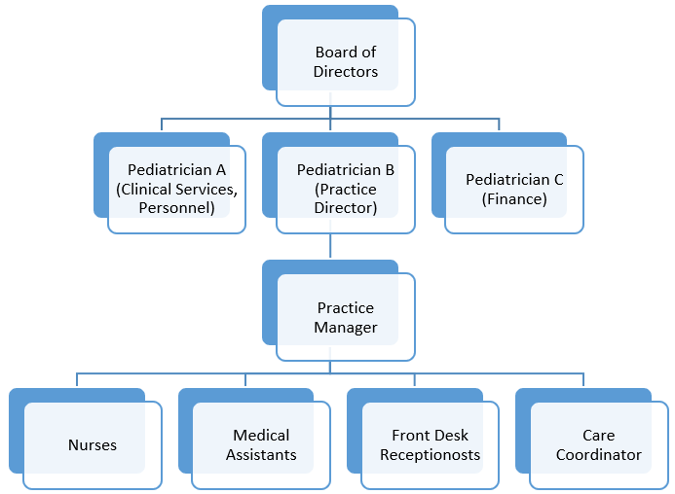
Nursing home organigram

Slide 13
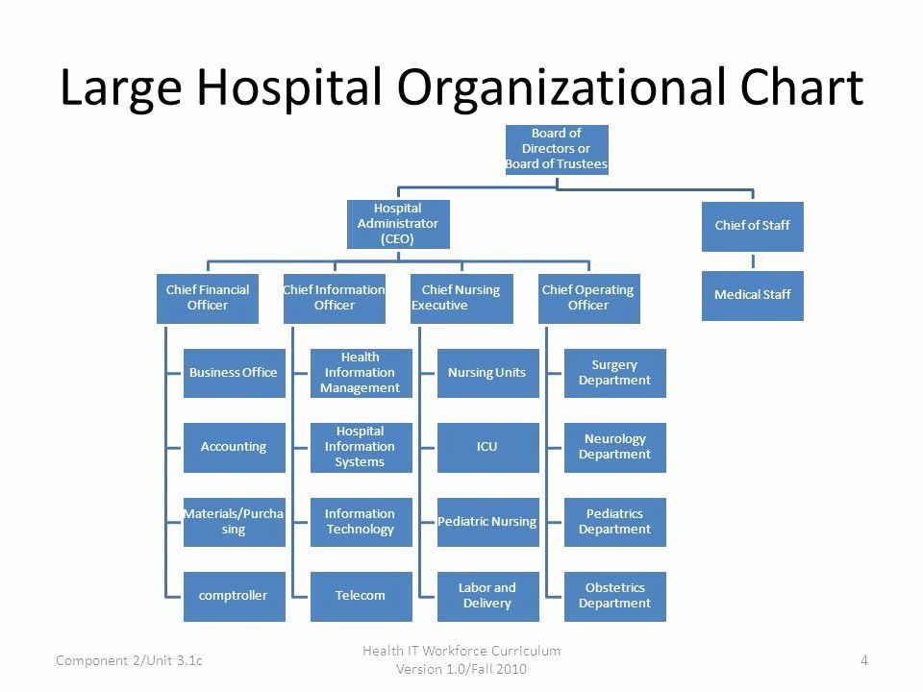

Slide 14
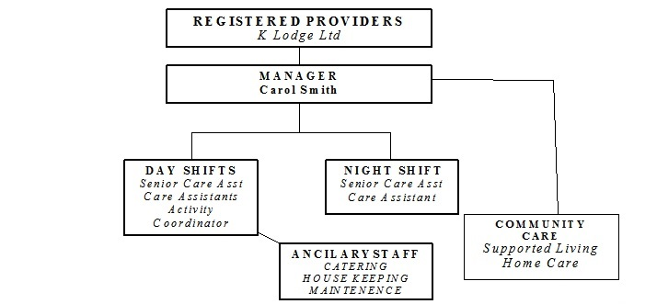

Slide 15
